Slide 1
Section 5 – Groundwater Macrophyte Figure

Slide 2
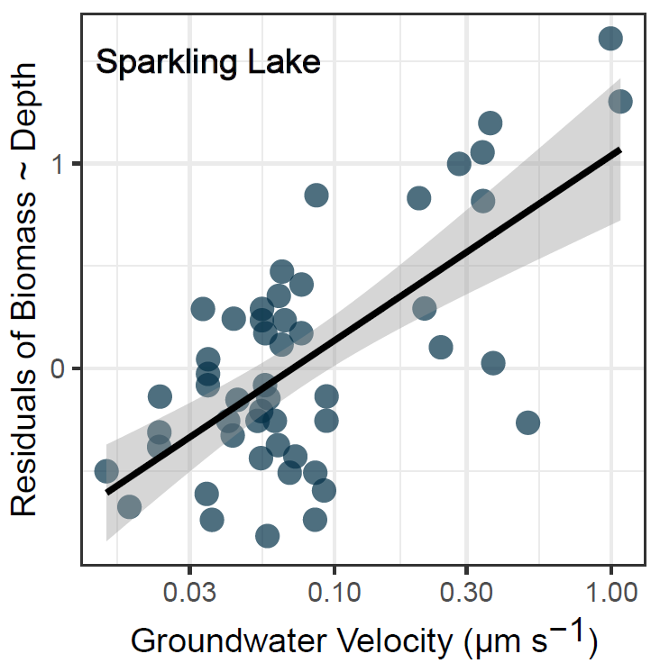


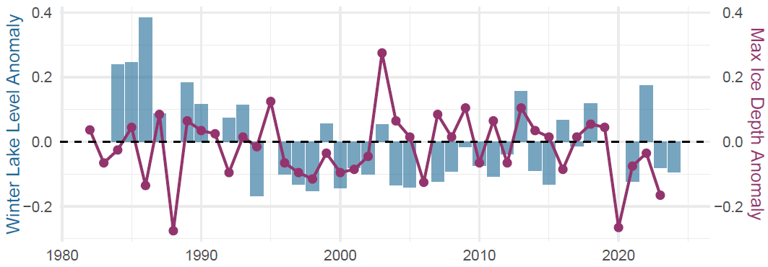



A) Sparkling Lake
Wet Year
B) Allequash Lake
Regular deep freeze facilitates annuals
Perennials, mudflats dominate
Hypothesized deep freeze
Dry Year
GW level
inflow
outflow

Slide 3


Slide 4
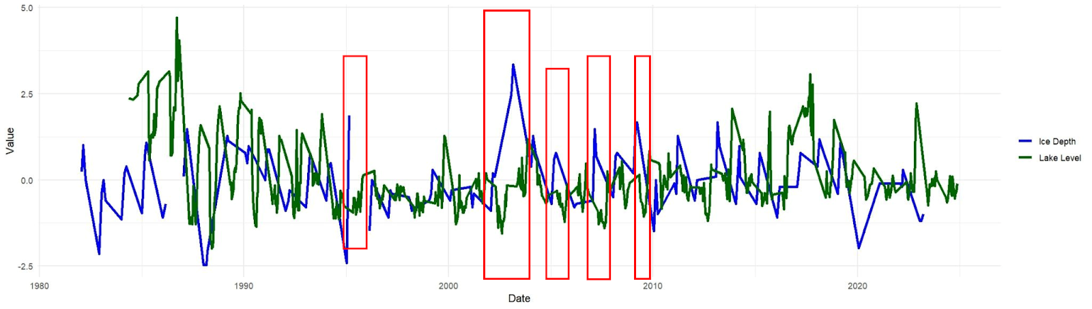
Hypothesized deep freeze winter

Slide 5
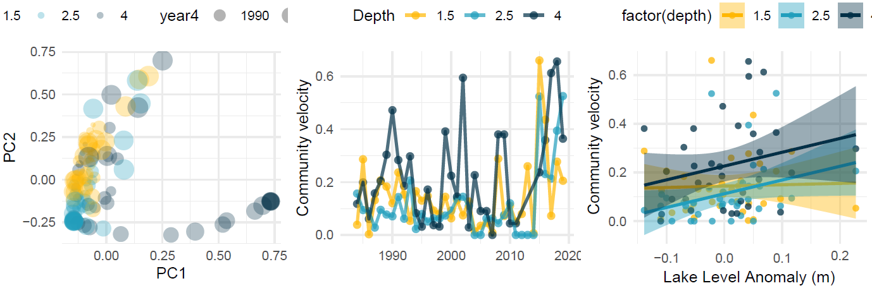
Trout Lake Macrophyte Community Trajectories
1.5 m
2.5 m
4.0 m
1983
2020
Trout Lake Macrophyte Community Trajectories
1.5 m
2.5 m
4.0 m
1983
2020
Figure 4. Annual macrophyte community composition (measurement = biomass) across depth in Trout Lake. Community velocity was quantified as the Euclidean distance between successive years in PCA space.

Slide 6
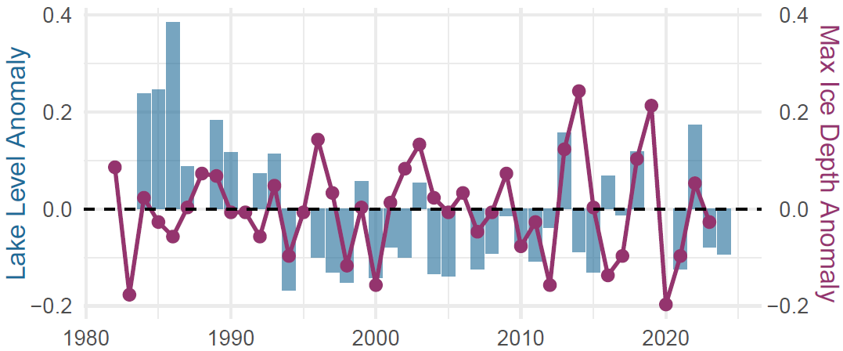
Trout Lake Macrophyte Community Trajectories
1.5 m
2.5 m
4.0 m
1983
2020
Figure 4. Annual macrophyte community composition (measurement = biomass) across depth in Trout Lake. Community velocity was quantified as the Euclidean distance between successive years in PCA space.
Hypothesized ice scour winter

